Slide 1
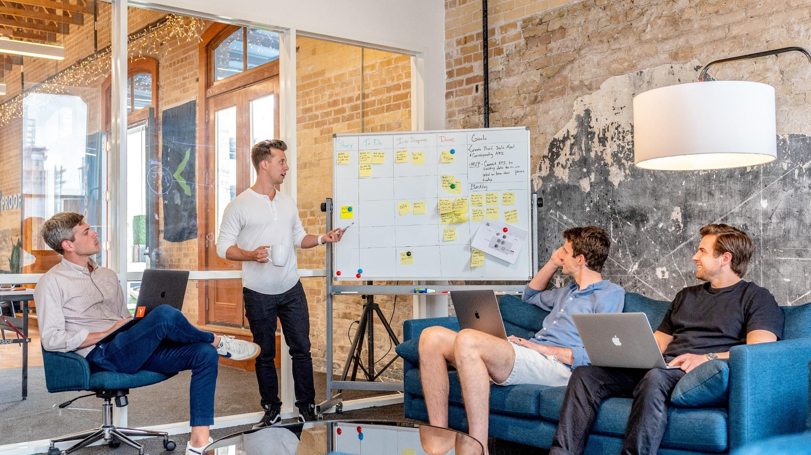
BRIGHT TV VIEWERSHIP ANALYSIS
BY MULAUDZI VF

Slide 2


AGENDA
Project intro
Usage
Analysis
Recommendation
Closing Remarks

Slide 3

Thank you for the opportunity to present insights into Bright TV’s user base and content consumption trends.
Our objective today is to demonstrate how we can drive daily viewership growth while aligning with Bright TV’s subscription expansion strategy for the current financial year.
In this session, we will analyze user behavior, viewing patterns, and content preferences, leveraging real engagement and viewership data. These insights will inform our targeted initiatives to:
Increase user engagement through personalized content experiences
Boost content consumption on low-activity days with strategic interventions
Expand the overall user base by optimizing outreach and retention strategies

Slide 4
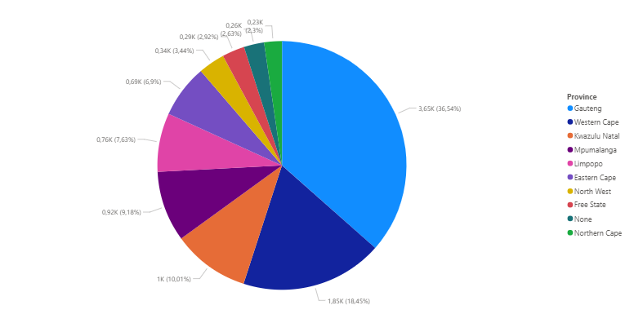
Viewership by province
The majority of BrightTV’s viewers come from urban and more connected provinces (Gauteng and Western Cape)
These regions likely have better access to internet and digital services, which facilitates higher streaming activity
Provinces with lower viewership may be underserved or face connectivity/access challenges

Slide 5
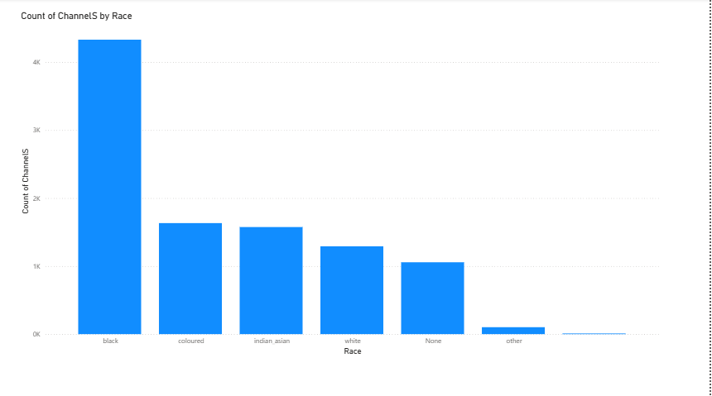
Viewership channels by Race
Black users have the highest channel engagement, with well over 4,000 channel interactions
Coloured, Indian/Asian, and White groups have similar channel engagement counts, ranging from 1,300 to 1,700.
None refer to users who did not declare their race or where data is missing

Slide 6
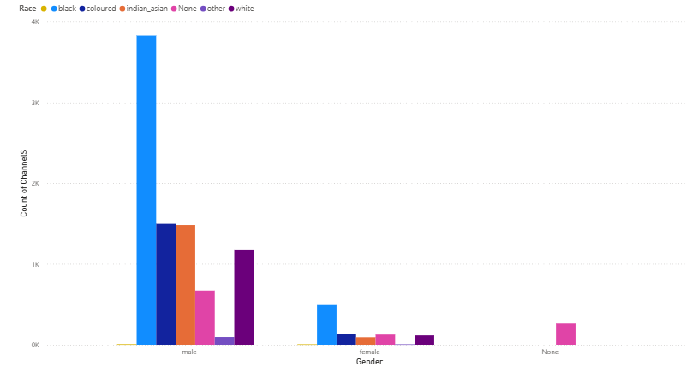
VIEWERSHIP BY RACE AND GENDER
Males make up 85% of sessions
Females contribute about 14%
None contribute 1%
Black males are the most dominant group

Slide 7
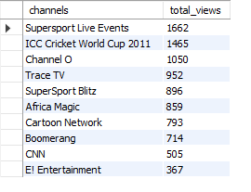
Top 10 most viewed channels

Slide 8
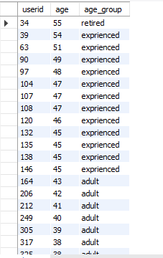
Age viewership

Slide 9
Things that can be done to influence growth of the viewership
Referral incentives
Localized content
Influencer collaborations
Cross-platform marketing
Strategic partnerships
.

Slide 10
Recommendations
Consider marketing partnerships or data-friendly streaming options in regions like Free State and Northern Cape
Highlight local content or free trial offers specific to underperforming provinces.
Partner with local creators or promote regionally relevant content.
Promote weekend family packages & offline downloads
adjust prime-time promotions to fit people who go to work

Slide 11

THANK YOU

